Slide 1
Risk of Heart Disease and Attack based on Health, Wealth and Education.
Andriani Christanty, Johanna Fernandez & Tristan Carlisle
GROUP 1 - PROJECT 1 UWA Data Analytics Boot Camp

Slide 2
Motivation
Although on the decline, Cardiovascular conditions still account for the largest proportion of deaths in Australia (27%) (DoH, 2021; Leeder, Gibberd, Dobson, Lloyd, & medicine, 1984)
More than 1 million Australians live with cardiovascular conditions such as heart disease, stroke or vascular conditions (DoH, 2021).
As these conditions account for such a large proportion of mortality, our group seek to assess what factors may be intertwined with thearts disease and heart attack. Thus, potentially develop mitigation strategies that can be implemented to reduce risk factors and ultimately save lives.

Slide 3

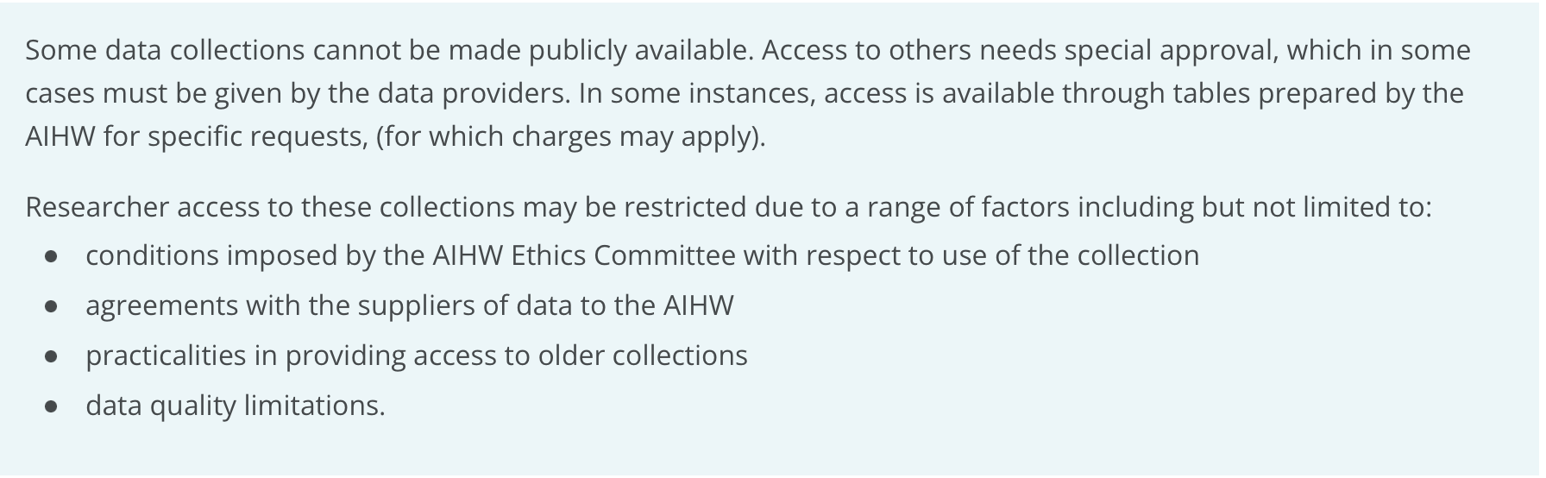
Limitations in finding Medical AU Datasets
(Australian Institute of Health and Welfare, 2021)

Slide 4


BRFSS 2015 Survey CSV
Found on Kaggle
Land-Line and Cell-Phone Survey Result
Included data for 50 American states, the District of Columbia Guam & Puerto Rico.
Originally 441, 456 records down to 253,680 records after the clean-up
(CDC & BRFSS, 2016)

Slide 5
Hypothesis
Refined Hypotheses
Ho: The level of income in a household does not impact a person’s risk to having a heart disease/ heart attack
Ha: As the person’s income goes up, it reduces the risk or exposure to having a heart disease / heart attack
Overarching Hypothesis
Lifestyle and health metrics influence a person’s risk of developing heart attack/heart disease.
Ho: There is no relationship between education level , mental/physical health and heart attack/ disease occurrence.
Ha: Education level, mental/ Physical health influence the likelihood of Heart attack/ disease occurrence.

Slide 6
Metrics as provided by BRFSS 2015 Survey
Alcohol Consumption
Access to Healthcare
General Health
Mental Health
Physical Health
Difficulty Walking
Sex
Age
Education
Cigarette Smoking
High Blood Pressure
High Cholesterol
Body Mass Index (BMI)
History of Stroke
Diabetes
Physical Activity
Daily Consumption of Fruits
Daily Consumption of Vegetables
Income
Notes:
Describe the questions you asked, and why you asked them
Describe whether you were able to answer these questions to your satisfaction, and briefly summarise your findings

Slide 7
Data Cleanup & Exploration
We went through each of the column in the CSV that we obtained, and made sure the values in each column were within the expected values. For this, we referred back to the CDC Code Guideline book (BRFSS Codebook, 2015).
As the CSV was already modified on Kaggle, some of the headers and the values in the columns did not correspond to those of the Codebook. We explored further the author’s website and were able to find some notes about these changes.

Slide 8
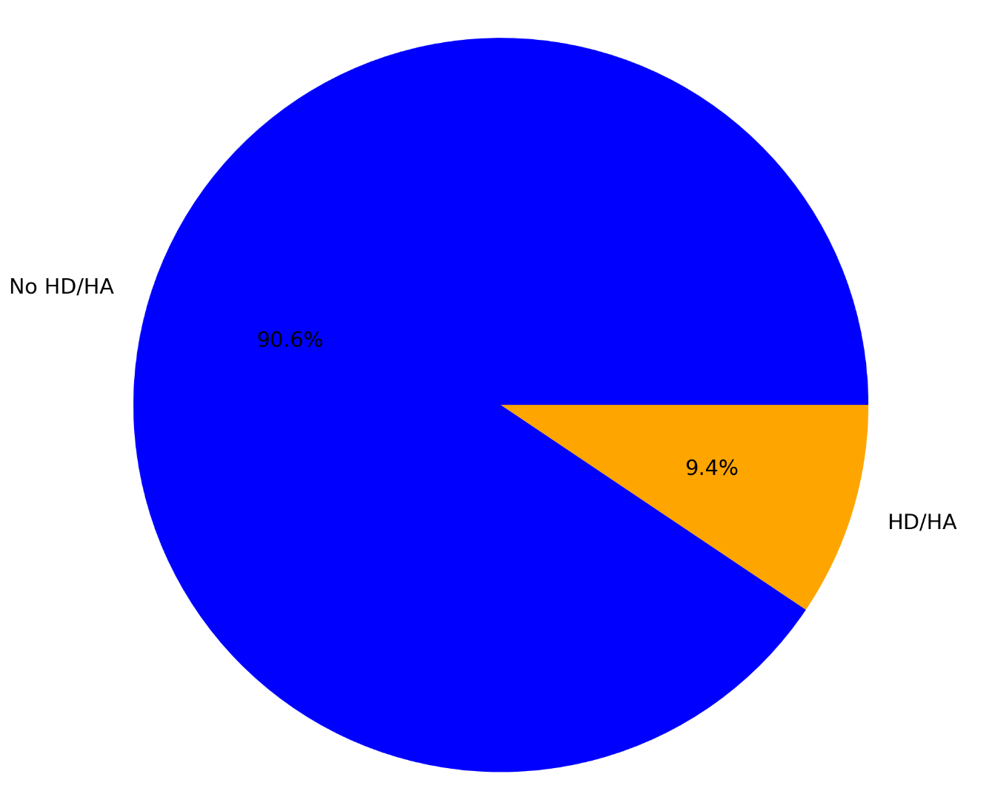
Prevalence of HD/HA in Sampled American Population - BRFSS 2015 Survey
Data Analysis and Discussion: Health metrics

Slide 9
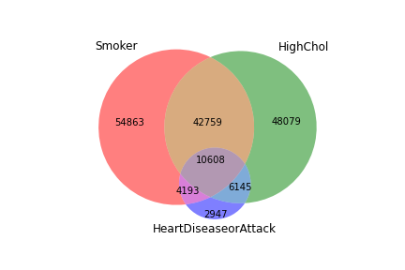
Cigarette Smoking, High Cholesterol & HD/HA
How common are overlaps among sampled population with HD/HA, smoking, high Cholesterol?
We are interested in seeing whether individuals who have HD/HA are more likely to have two risk factors
Overlaps can be seen among the three, with - Most people with HD/HA (44%) have 2 risk factors (smoking cigarettes & High Cholesterol), while 17% are smokers without high cholesterol, and 26% are people with high cholesterol who are not smokers

Slide 10
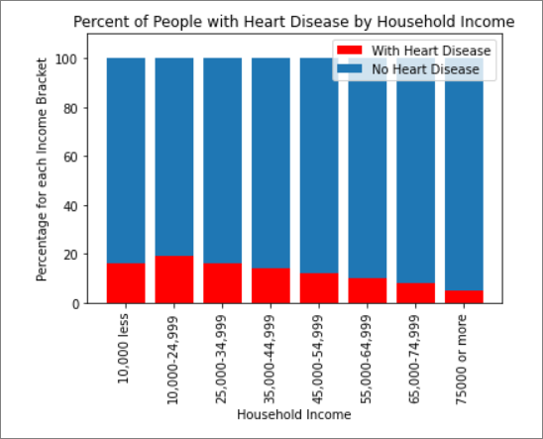
Analysis & Discussion: Income
Is there a relationship between income and HD/HA?
From $10,000 onwards we see a steady decrease in the proportion of people with HD/HA over the total population for each income bracket
This could have an interaction with accessibility to medical care and other fitness and lifestyle facilities.

Slide 11
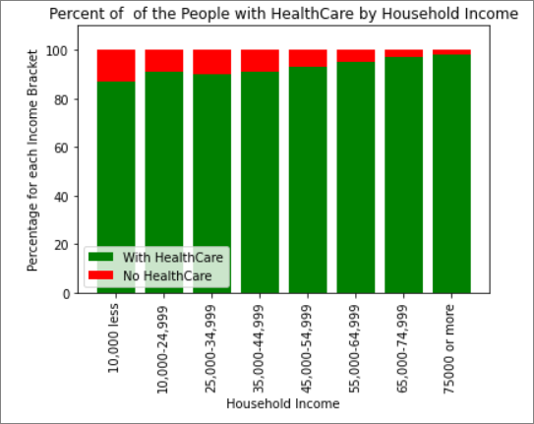
Analysis & Discussion: Income & HealthCare Access
Does the person’s income impact their access to Health Care
We see an increase to the percentage of people having access to HealthCare as their income increases

Slide 12
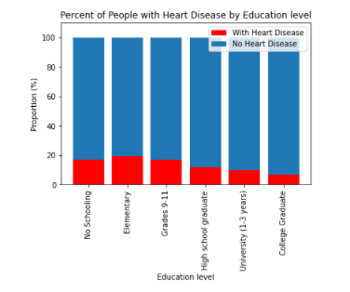

Analysis & Discussion: Education
Education and heart disease/attack
Ho: Education and heart disease/attack are independent from each other.
Ha: Education and heart disease/attack are dependent on one another.
A Chi-squared test was completed as we have categorical data
P-values < 0.05 thus, dependency established

Slide 13
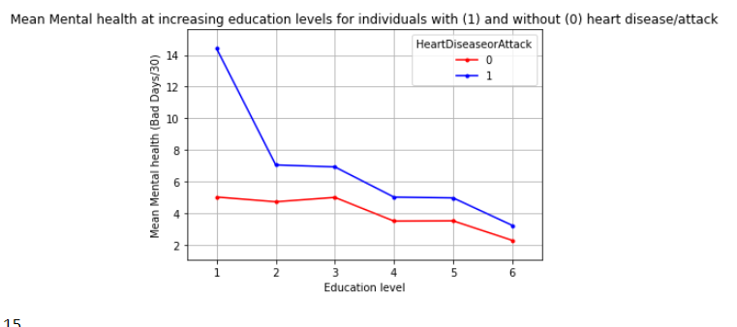
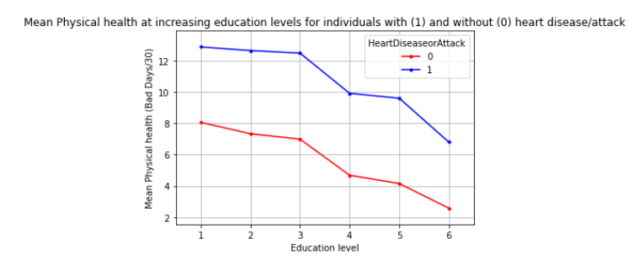
Analysis & Discussion
The interplay between Education and Health
Two way ANOVA with interaction: P-value (<0.01)
Tukey post hoc
tukey_hsd
Shapiro wilks and levenes (normality and homogeneity of variance)

Slide 14
Post Mortem
Post Mortem
Challenges:
Matplotlib-Venn not in the original Matplotlib package
We had a mixture of count and continuous data integrating them in order for statistical tests was a challenge.
Further Research:
Discuss any additional questions that came up, but which you didn't have time to answer: What would you research next, if you had two more weeks?
It may be useful if we are able to find more BRFSS Survey datasets from subsequent years so that we can analyze the trend
Developing more charts and diagrams composed of various different metrics may provide us with valuable insights
Assessing how various categories of education may impact health metrics and HA/HD occurrence
Linking access to Health care, and fitness facilities with income to assess how income influences HA/HD occurrence
Looking into accessing Australian datasets
Notes:
We thought that developing a Venn diagram would help in visualizing the relationships of some variables, however Matplotlib did not have the tool for it in the initial package. We eventually installed an additional package (Matplotlib Venn) for this purpose

Slide 15
Summary & Implications
Most people with HD/HA (44%) have 2 risk factors (smoking cigarettes & High Cholesterol), while 17% are smokers without high cholesterol, and 26% are people with high cholesterol who are not smokers
Can explore developing a program alerting HCP when their patients possess the two risk factors, so that a plan aimed at eliminating or reducing at least one of the two metrics can be initiated
Yearly wage influences HA/HD occurrence. Although this may not be a direct influence the trend is present. A majority of the population has a health care plan however, we see a slight increase in proportion as income increases.
Raising the minimum wage may reduce the occurrence of HA/HD. Furthermore, introduction of more comprehensive health care plans may be adequate. However, further research is required to assess which factors should be addressed in this plan.
Education and HD/HA are dependent variables (p < 0.01). As education level increases we see a drop in HD/HA. Furthermore, as education levels increased the number of bad days in last 30 days dropped. Education may give individuals the ability to cope with hardships and manage physical health.
We recommend government intervention to increase accessibility to higher education. Addition to Education budget could reduce cost associated with medical facilities to house patients with HA/HD as well as facilitate economic growth.

Slide 16

Questions

Slide 17
References
(DoH), A. G. D. o. H. (2021). What we’re doing about cardiovascular conditions. Retrieved from https://www.health.gov.au/health-topics/chronic-conditions/what-were-doing-about-chronic-conditions/what-were-doing-about-cardiovascular-conditions
Australian Institute of Health and Welfare. (2021, September 16).
Reports & data. AIHW. Retrieved February 6, 2022, from https://www.aihw.gov.au/reports-data
CDC & BRFSS. (2016). Behavioral Risk Factor Surveillance System 2015 Codebook Report
Land-Line and Cell-Phone data [E-book].
Leeder, S. R., Gibberd, R., Dobson, A., Lloyd, D. J. A., & medicine, N. Z. j. o. (1984). Declining mortality rates from ischemic heart disease in Australia. 14(4), 388-394.
Teboul, Alex. “Heart Disease Health Indicators Dataset Notebook.” Kaggle, Nov. 2021, www.kaggle.com/alexteboul/heart-disease-health-indicators-dataset-notebook. Accessed 5 Feb. 2022.

Slide 18
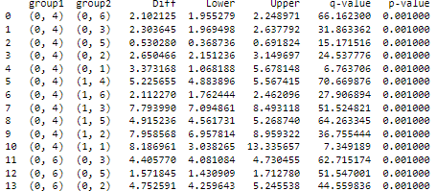
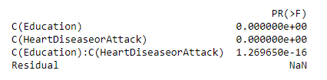
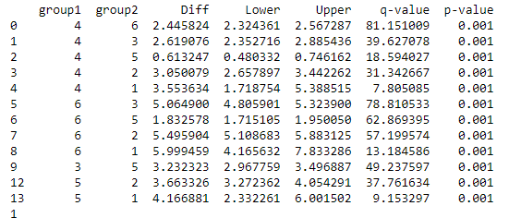
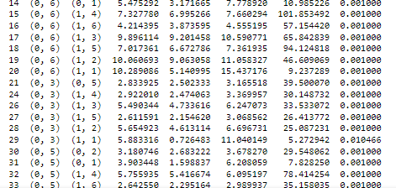
Appendix
TUKEY (HA/HD)
TUKEY (interaction)
Physical health
ANOVA
TUKEY (education)
1 non significant
15/66 non significant

Slide 19
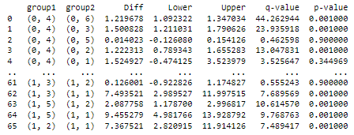

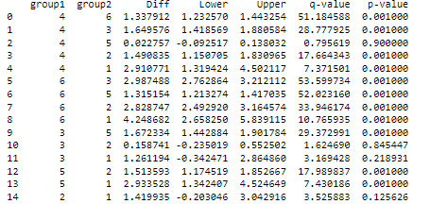
Appendix
TUKEY (HA/HD)
TUKEY (interaction)
Mental health
ANOVA
TUKEY (education)
16/66 non significant
4/15 non significant

